Slide 1
The Positive Effects of Hungary's Thermal Waters
Made by: Baracsi Karina Edit and Hajdú Nikol Jázmin

Slide 2
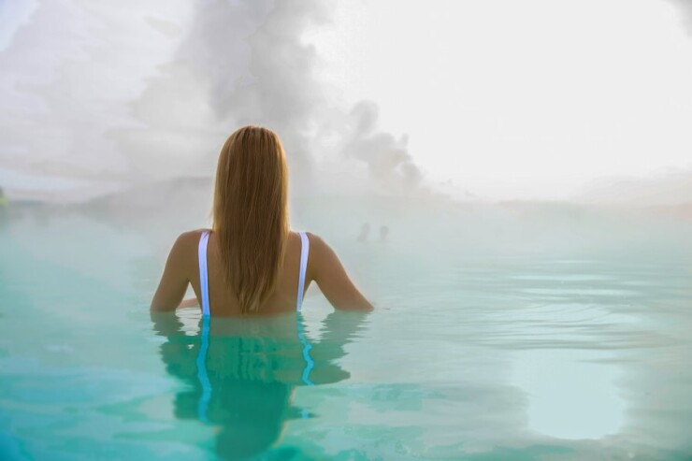
The Healing Benefits of Hungary's Thermal Waters
Hungary is known for its rich natural resources, including numerous thermal springs. These thermal waters are famous for their healing properties and are used in spas and wellness centers throughout the country. Here are some of the positive effects they have on health:

Slide 3
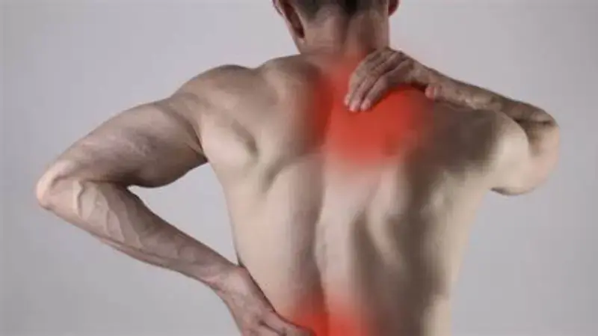
1. Pain Relief
Thermal waters are often used to relieve joint and muscle pain. The heat helps to relax the muscles and joints, which can reduce pain from conditions like arthritis, rheumatism, and sports injuries.

Slide 4
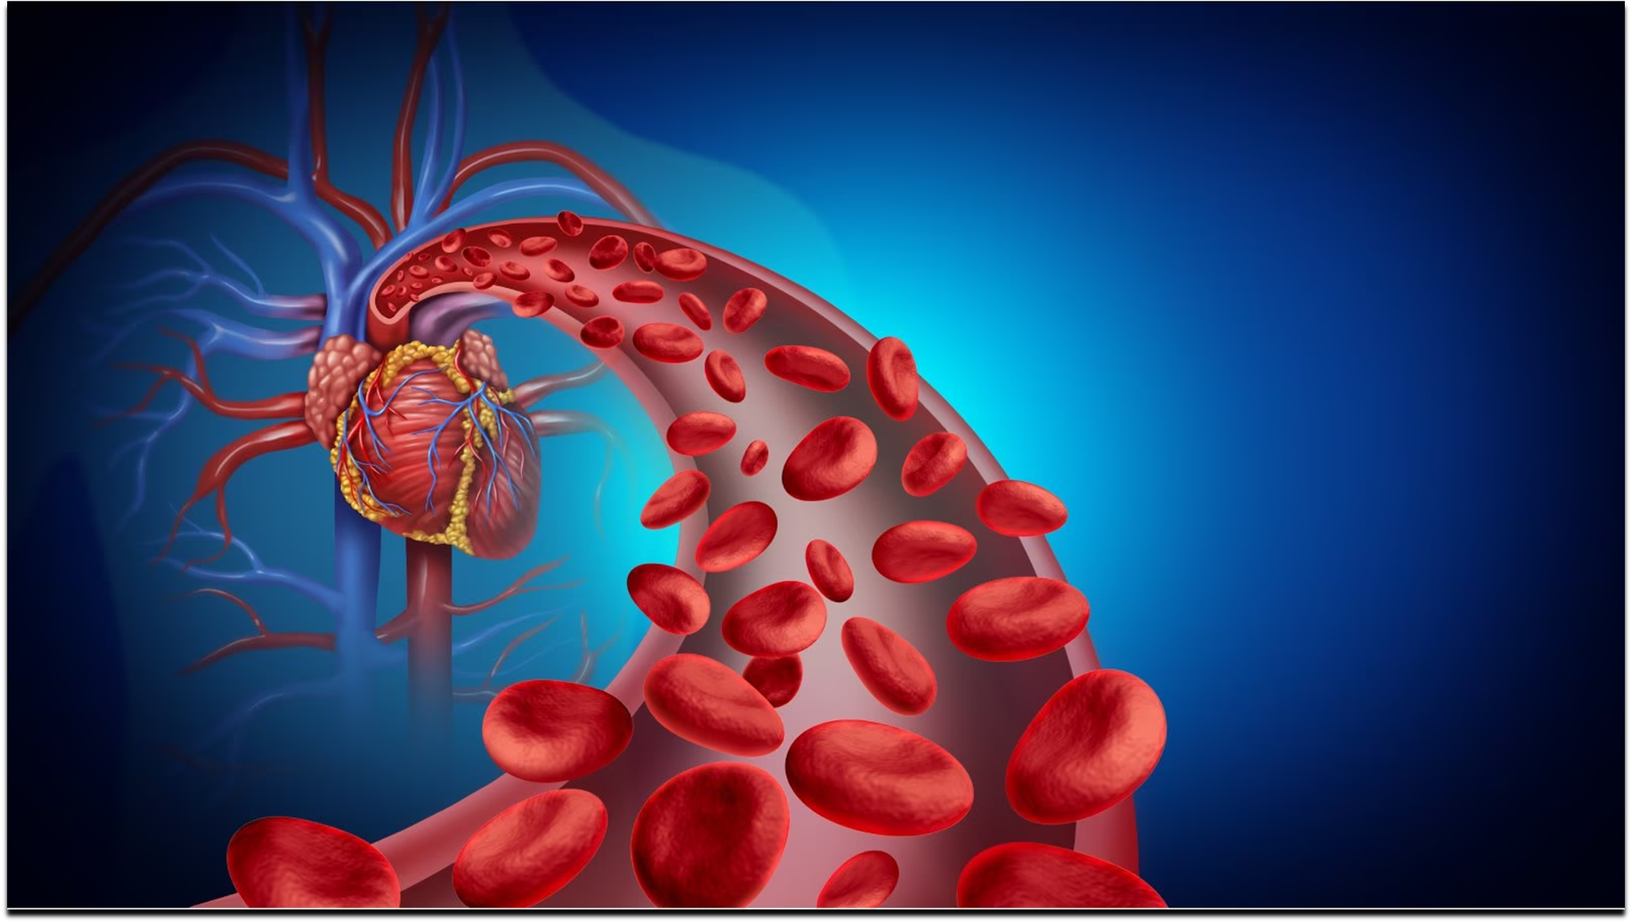
2. Improved Circulation
The warmth of the thermal water improves blood circulation, which can help deliver more oxygen and nutrients to tissues and speed up the healing process. This can be beneficial for people suffering from circulatory problems.

Slide 5

3. Stress Reduction
Soaking in thermal water can help reduce stress and anxiety. The warmth soothes the body and mind, promoting relaxation and mental well-being.

Slide 6
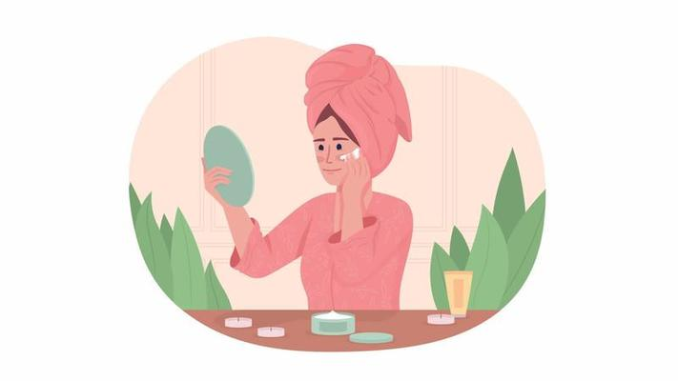
4. Skin Health
Many of Hungary's thermal springs contain minerals like sulfur, calcium, and magnesium, which are known to improve skin health. These minerals can help treat skin conditions like eczema, acne, and psoriasis.

Slide 7

5. Detoxification
Bathing in thermal water helps the body sweat, which can assist in removing toxins and impurities from the skin and body.

Slide 8
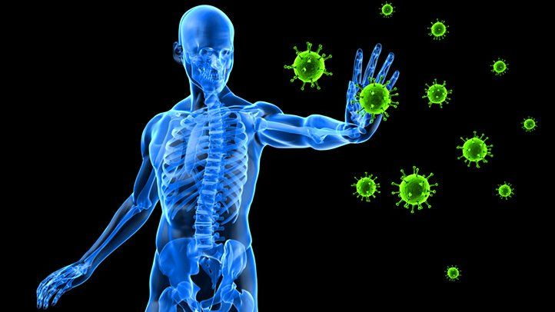
6. Boosted Immune System
Regular exposure to the mineral-rich thermal waters is said to help strengthen the immune system by increasing the body's resistance to infections and promoting overall health.

Slide 9
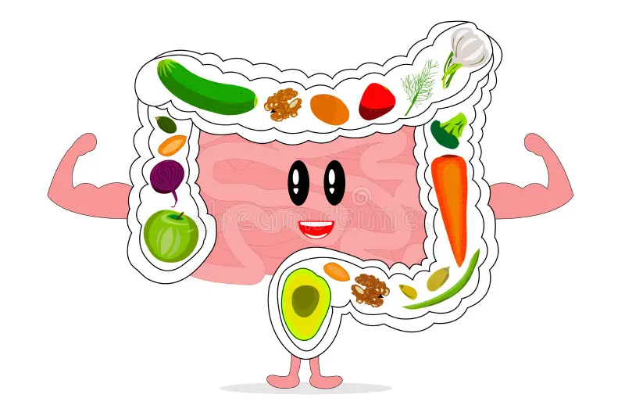
7. Better Digestion
Some thermal waters are used for drinking therapy. The mineral content of these waters can aid in digestion and help with digestive problems, such as indigestion and constipation.

Slide 10

8. Rehabilitation and Recovery
Thermal water treatments are often used in physical rehabilitation programs to speed up recovery from injuries or surgeries. The heat promotes healing and helps prevent muscle stiffness.

Slide 11
Hungary’s thermal and medicinal water types
Thermal water
Medicinal water
Mineral water
Sulfuric water
Carbonated water
Radioactive water
Alkaline water
Iodine-rich water
Bromine-rich water
Salty water (Saline water)
Ferruginous (Iron-rich) water

Slide 12
Conclusion
Hungary's thermal waters are not just a relaxing way to spend time, but also a powerful natural remedy for many health problems. Whether used for relaxation, pain relief, or improving skin health, these waters have been trusted for centuries to improve both physical and mental well-being.

Slide 13

Thank you for your attention!

